Slide 1

DEPARTMENT OF COMPUTER SCIENCE AND ENGINEERING
A Project Presentation on
"WIRELESS DIGITAL NOTICE BOARD USING RASPBERRY PI"
Presented By,
VRUSHAB H 01JST16CS118
K.V.SAMPRITHA RAO 01JST16CS128
HARIPRASAD M.V 01JST17CS403
Under the guidance of
DIVAKARA. N
Assistant Professor
Dept. Of Computer Science and Engineering

Slide 2
AGENDA
INTRODUCTION
PROBLEM STATEMENT
EXISTING SOLUTION METHODS
PROPOSED METHODOLOGY
TOOLS AND TECHNOLOGY USED
SYSTEM DESIGN
IMPLEMENTATION
APPLICATION
CONCLUSION
FUTURE WORK

Slide 3
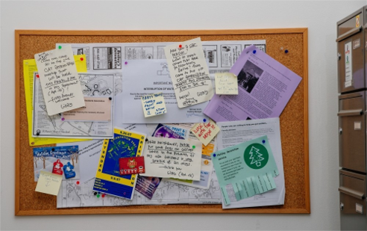
INTRODUCTION
Notice board is an essential tool that is used to display important messages or general information to the public
Used in various places like
-> Educational institutions
-> Railway Stations
-> Bus Stands
-> Government Office
Fig.1:A Conventional Notice Board

Slide 4
PROBLEM STATEMENT
To provide an alternative to traditional notice boards, that helps to save paper, manual work and eases the administration's tasks.
Build a digital notice board using Raspberry Pi which can receive notices wirelessly over the internet from authorized administrators and display it on the screen.

Slide 5
EXISTING SOLUTION METHODS
Manually writing or typing of messages and sticking on physical notice boards.
Using boards and changing slates.
Bluetooth based notice board.
GSM Based notice board

Slide 6
PROPOSED METHODOLOGY
Consists of 3 modules:
Raspberry Pi – Uses Raspberry Pi Model B for wireless network and Bluetooth connectivity capability.
GSM – Uses a SIM to send SMS to users without android phones and internet availability.
User Interface – To access the application.

Slide 7
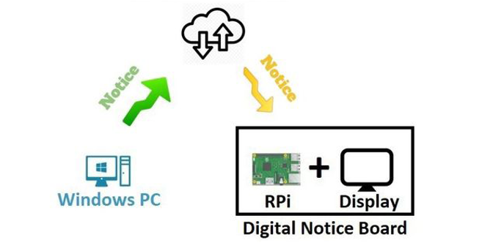
PROPOSED METHODOLOGY
Fig.2: Flowchart of the working model

Slide 8






TOOLS AND TECHNOLOGY USED

Slide 9
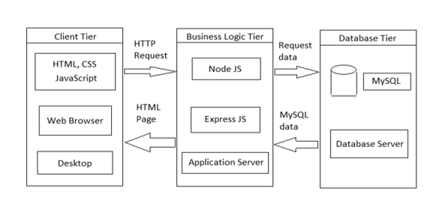
SYSTEM DESIGN
Fig. 3 Three Tier architecture of overall working model

Slide 10
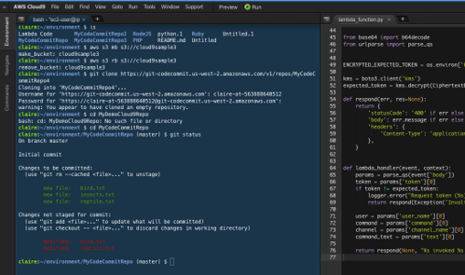
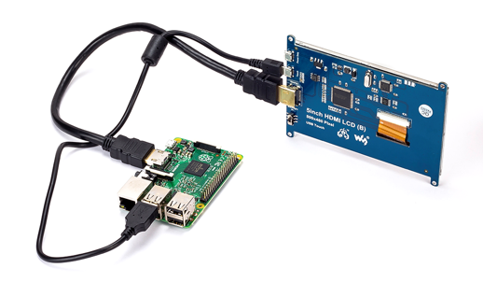
SYSTEM IMPLEMENTATION
Project is implemented in 2 parts:
Software implementation
Hardware implementation
Fig.4:Software Implementation
Fig.5:Hardware Implementation

Slide 11


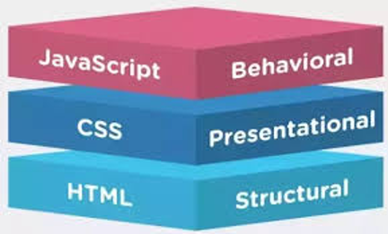

SOFTWARE IMPLEMENTATION
Fig.6: Structure of three technologies
Fig.7:Amazon Web Services

Slide 12
HARDWARE IMPLEMENTATION
Our project’s hardware implementation has been classified into two parts:
Interaction between Raspberry pi and the display Monitor.
Interaction between Raspberry pi and the GSM Module.

Slide 13
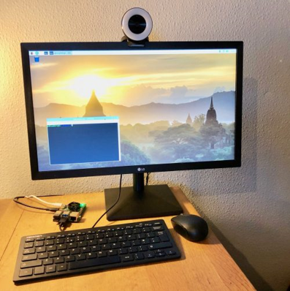
INTERACTION BETWEEN RASPBERRY PI AND THE MONITOR
Raspberry Pi is connected to monitor via HDMI cable.
Node modules embedded in the Pi will receive text messages and media files such as docs, pdf's and images sent from the application's user interface.
The messages received by the Pi will be uploaded into the notice board, which is the monitor.
Fig.8: Raspberry Pi interaction with monitor via HDMI

Slide 14
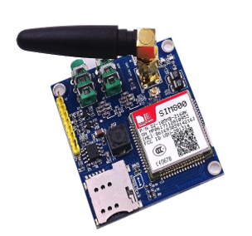
INTERACTION BETWEEN RASPBERRY PI AND THE GSM MODULE
Working of GSM Module
Place a valid SIM card into a GSM modem, which is then connected to a Raspberry pi.
Connect a GSM modem to a computer, to control the modem by sending instructions to it.
The instructions used for controlling the GSM modem are called AT commands (ATtension commands).
Fig.9: GSM Module

Slide 15
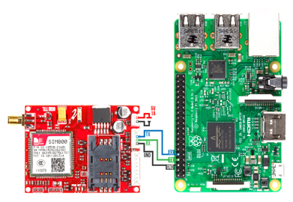
CONTINUATION..
To implement this module, follow the steps:
Connect the Raspberry pi to the SIM800 Module by making use of the given connection table.
Disable serial console to enable communication between the pi and SIM900A via serial0.
Open the terminal on your pi and run
• sudo rasp-config
• Select Interfaces → Serial
• Select “No” to the 1st prompt and “Yes” for the 2nd.
Now it’s time to code. Import the necessary module
Fig. 10:GSM interfacing with Raspberry Pi
SIM900A | Raspberry Pi 3
RX | TX
TX | RX
GND | GND

Slide 16

APPLICATIONS
Hospitals
Railway Station
Schools and Colleges
Banks

Slide 17
CONCLUSION
The wireless digital notice board developed helps to ease the process of displaying notices. It makes use of Raspberry Pi and GSM module to be able to display and view important messages to the public via the internet on Android phones and as a text message on non-Android phones.
The system is capable of supporting text messages, images, links, etc. which can be displayed. It is also possible to upload student attendance status, internal marks and so on provided the teachers keep updating this information.

Slide 18
FUTURE WORK
Display of QR code for the public to scan and view any notices or images or website, which can be displayed on the monitor situated in campus.
Provide a page for faculty and facility feedback from which can be filled by all students and then analyzed by the department administration to realize what improvements and changes need to be done to give satisfactory education to the students.
Get daily news updates on the happenings in colleges by various clubs and the activities they are conducting. Also provide option for enrolling to these events online itself.

Slide 19
RESEARCH PAPER DETAILS
Our research paper titled "WIRELESS DIGITAL NOTICE BOARD USING RASPBERRY PI" has been published in the IJTRE (International Journal For Technological Research in Engineering), Volume 7,Issue 12, August-2020.
ISSN(Online): 2347-4718

Slide 20
Thank You!

